Slide 1

IRR-ANX Motion Update: April 2025
Lior Raymond
Halel Adorian
Zoë E. Laky
&
Reut Naim

Slide 2
Background
[To Add]

Slide 3
Hypotheses
[To Add]

Slide 4
Sample
[To Add]

Slide 5
EXAMPLE SLIDE: Stop Signal Task (SST) Pre-processing
“Participants’ stop-signal delay-task data were excluded if the task was incomplete or if the mean reaction time to go trials was 200 ms longer than their reaction time during practice (indicating strategic slowing during the experimental task that interferes with the stop-signal delay algorithm...” (Cardinale et al., 2024)
3 participants removed for incomplete task data
19 participants removed for low go accuracy (<70%)
19 participants removed for slowed trial (vs. practice) go reaction time
Flag: ID 23855 has no practice data (included) – instead exclude?

Slide 6
EXAMPLE SLIDE: Task Summaries
Task | Number of Participants with Data
SST | 243
Flanker | 285
AS | 156
AX-CPT | 127
Number of Complete Tasks | Number of Participants
1 | 70
2 | 103
3 | 89
4 | 67

Slide 7
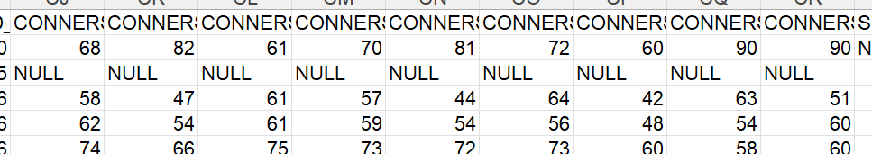
Task (SST) Pre-processing
Removing 2 participants with bad data (21666, 23559).
Adding a new column “Bad ET” (23149, 24234), for us to remember not to include them in advanced analyses.
Removing the Orange columns.
Adding “Null” in empty cells (necessary for boxplots).
Adding a new column “Dx binary” (just in pandas for t tests).

Slide 8
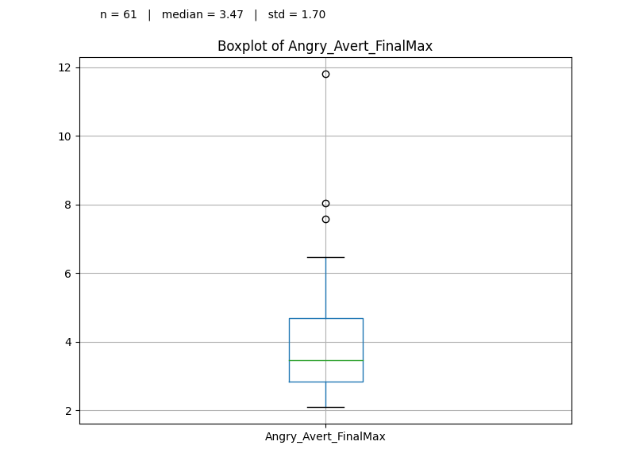
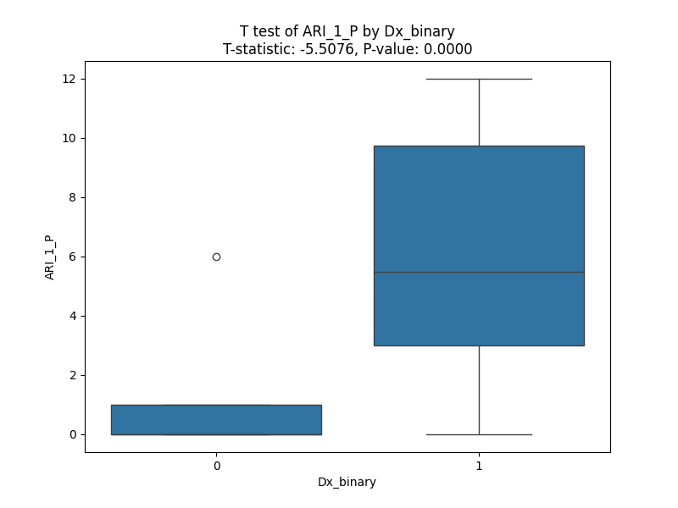
Task Summaries
Finished cleaning Data.
Box plots
T tests

Slide 9
Affective Reactivity Index (ARI) Pre-processing
Adding a new column “Dx binary” (just in pandas for t tests).
4 relevant columns:
ARI_1_C
ARI_1_P
ARI_6_C
ARI_6_P
For now, we did 4 t tests (one for each).

Slide 10
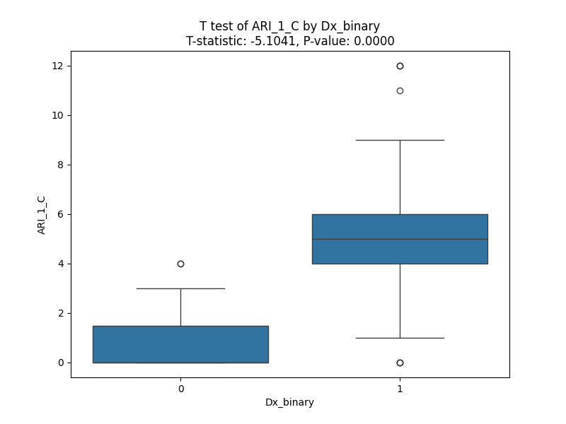
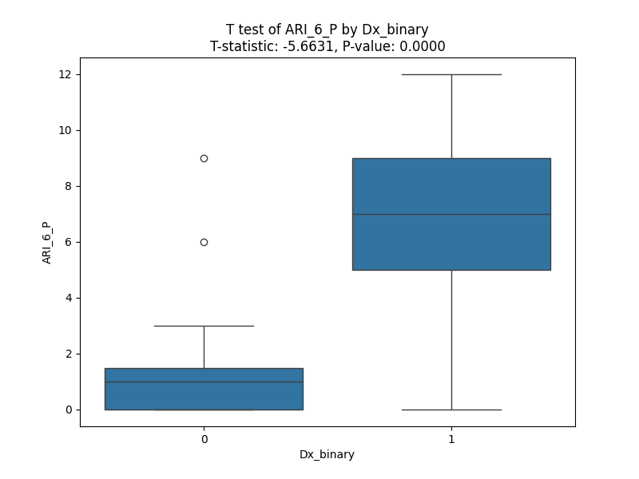
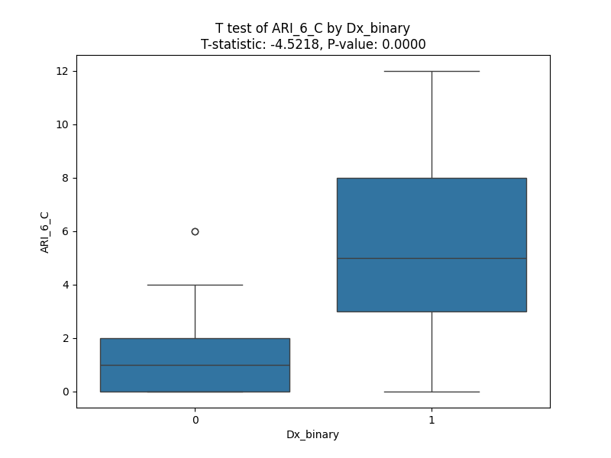
ARI Summaries

Slide 11
Screen for Child Anxiety Related Disorders (SCARED) Pre-processing
Adding a new column “Dx binary” (just in pandas for t tests).
2 relevant columns:
SCARED_C
SCARED_P
For now, we did 2 t tests (one for each).

Slide 12
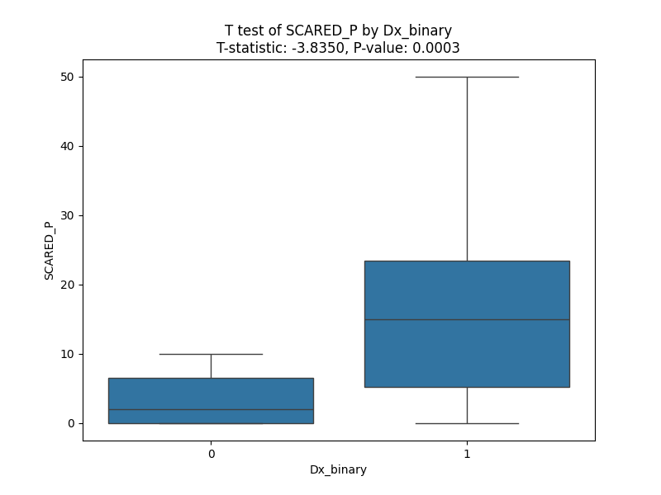
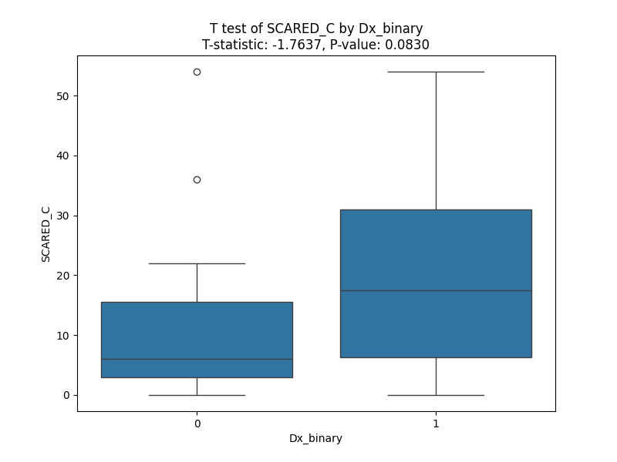
SCARED Summaries

Slide 13
Analysis Plan
[Zoë To Add]

